Slide 1

The Modernisation Factory
Industrialising Digital Evolution
Transform legacy estate management from a reactive burden into a high-throughput engine that reduces risk and technical debt at scale.
01
Notes:
We're here to talk about transforming how we manage our technology estate. The core idea is simple: we must stop treating legacy estate management as a reactive burden and start industrialising it. This is about moving from bespoke, one-off projects to a high-throughput engine. We call this the Modernisation Factory. It’s a framework designed to systematically reduce risk and technical debt at scale, turning a liability into a managed asset. We need to shift our mindset from simply maintaining the past to actively engineering the future. This factory approach gives us the control and predictability we desperately need in our digital evolution. It ensures that every pound we spend on modernisation is targeted, efficient, and delivers measurable business value. But before we discuss the solution, we must first confront the problem that makes this factory necessary.

Slide 2

The Cost of Inaction
The Legacy Tax
IT Budget Allocation
Maintenance
Innovation
Organisations spend the majority of their technology budget maintaining existing systems rather than building new capabilities. This is the hidden tax of technical debt.
02
Notes:
The problem we face is the Legacy Tax. This is the hidden, insidious cost of technical debt that quietly drains our resources and stifles innovation. Look at how our budget is allocated: the vast majority goes simply to keeping the lights on, maintaining existing systems. This maintenance spend is not an investment; it is a tax we pay for past architectural decisions and deferred maintenance. It’s a zero-sum game where every pound spent on upkeep is a pound not spent on building new, competitive capabilities. This imbalance is fundamentally unsustainable for a business that needs to move with speed and agility. We are effectively paying a premium just to stand still, and that premium is growing every year. We need to reverse this trend and free up capital for genuine innovation. So, what exactly is driving this tax?

Slide 3
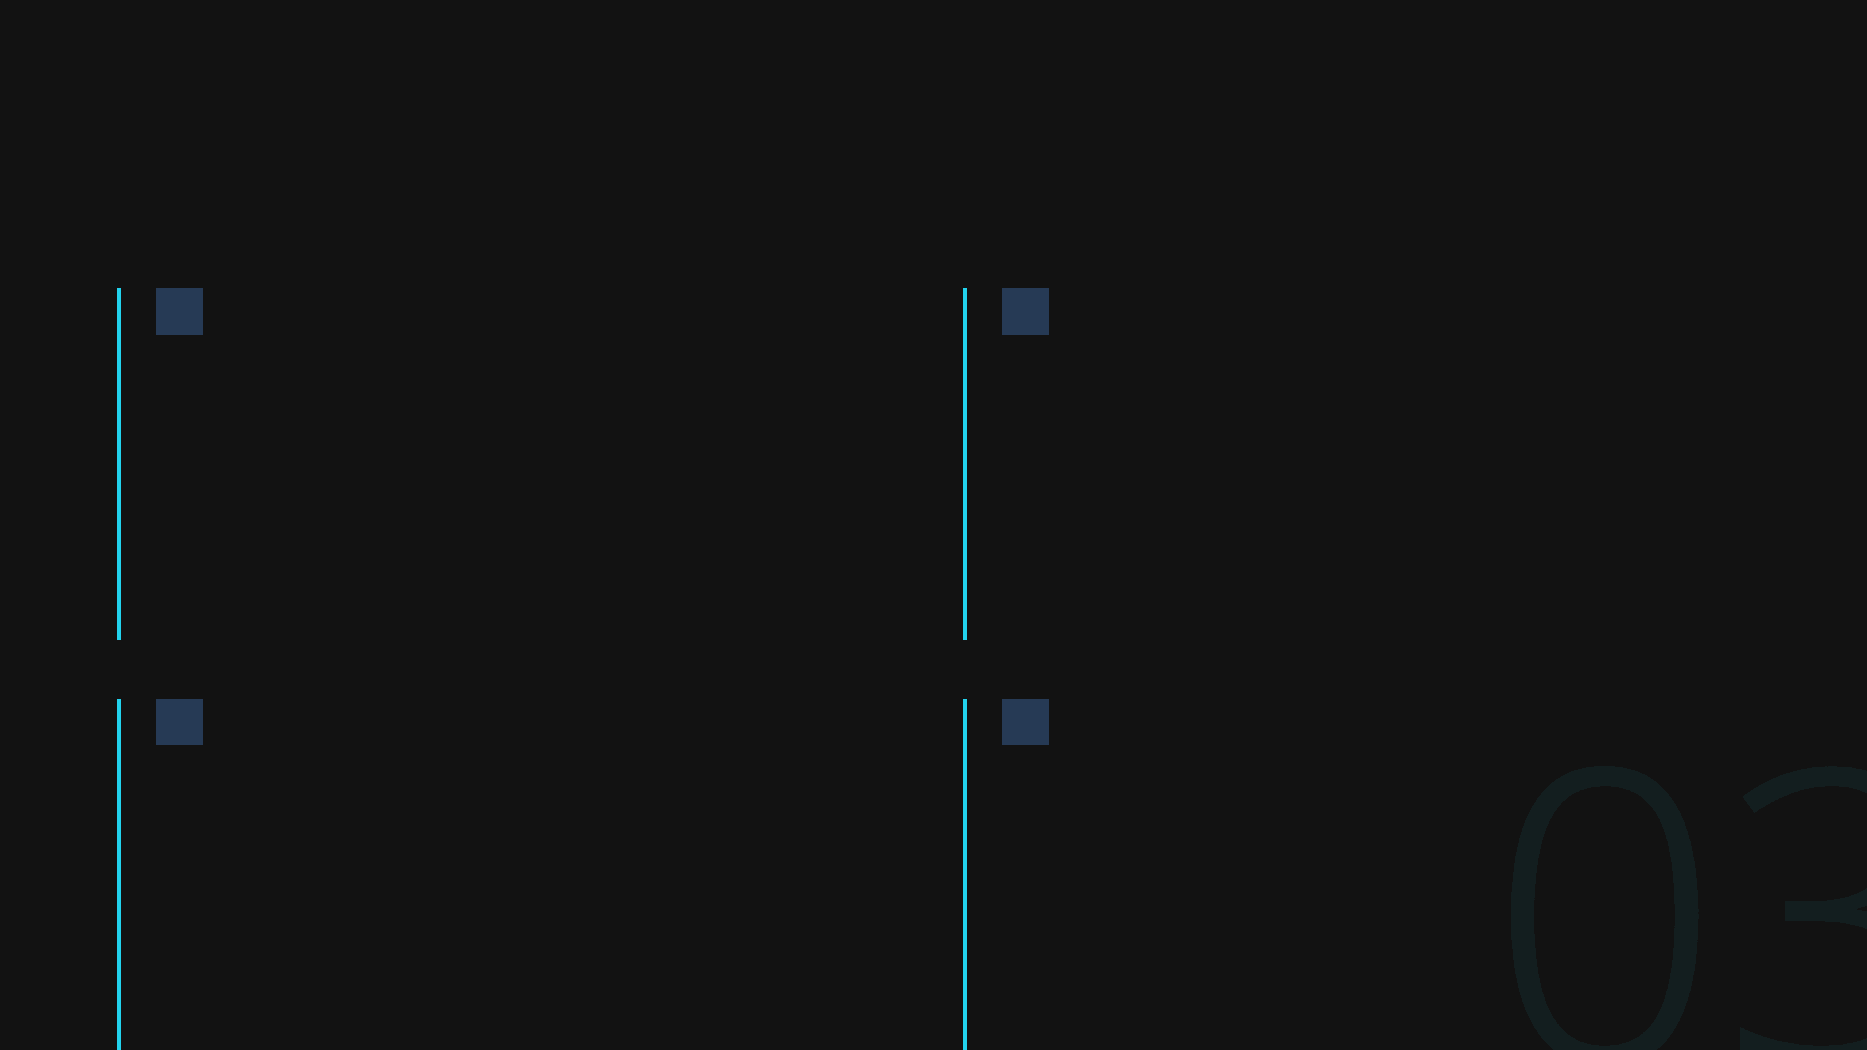
The Velocity Killer
The Reality of the Estate
Undocumented Systems
Monolithic Architecture
Critical business logic exists only in the minds of developers who may no longer be with the organisation.
Tightly coupled systems where a single change can cascade into unexpected failures across the entire platform.
03
Dead Libraries
Tribal Knowledge
Dependencies on unsupported frameworks and libraries that create security vulnerabilities and compatibility issues.
Operational procedures that exist nowhere in documentation, making maintenance risky and training nearly impossible.
Notes:
The Legacy Tax is driven by the harsh reality of our current technology estate. This reality is a velocity killer, slowing down every initiative we launch. We are plagued by undocumented systems where critical business logic is held hostage by tribal knowledge, residing only in the minds of a few long-serving colleagues. This creates massive key-person risk. Furthermore, our monolithic architectures mean that even the smallest change requires disproportionate effort and carries huge risk of cascading failure. And finally, we have dead libraries and unsupported dependencies, which are ticking time bombs for security and compliance. We cannot continue to operate with this level of inherent risk and inefficiency. We need a systematic way to tackle this complexity head-on. This is precisely why we need a factory approach.

Slide 4

A Unified Approach
The Factory Framework
Rather than treating each legacy application as a unique problem, the Modernisation Factory establishes a unified intake funnel that systematically processes applications through standardised pathways.
Step 1
Wide Intake Funnel
Step 2
04
Automated Discovery & Triage
Step 3
Streamlined Assembly Lines
Notes:
The Factory Framework is our answer to the chaos of the legacy estate. Instead of treating every application as a unique, artisanal problem requiring a bespoke team, we establish a unified, industrialised process. This framework standardises the entire modernisation journey. It begins with a wide intake funnel, ensuring we capture all applications for assessment. We then move to automated discovery and triage, which intelligently classifies each application based on its technical state and business value. Finally, we route them through streamlined assembly lines, which are pre-defined, repeatable processes for modernisation. This systematic approach brings predictability, efficiency, and scale to what has historically been a highly unpredictable and costly exercise. And it all starts with the intake process.

Slide 5
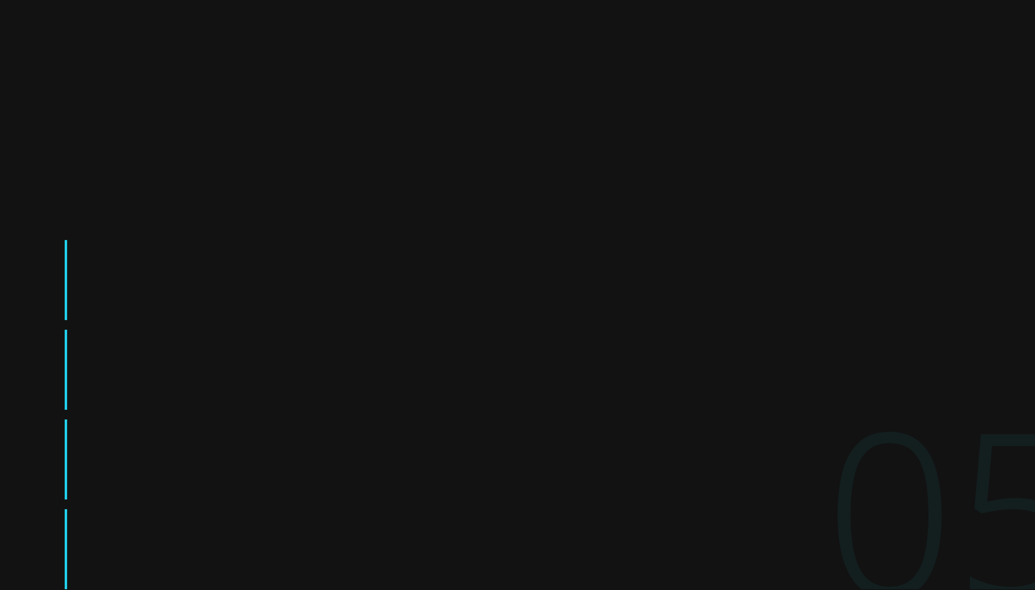
Automated Discovery
Intake: The Digital X-Ray
Using AI-driven discovery tools and static analysis, we map the complete dependency network of each application without requiring input from original developers.
1
Dependency Mapping
Leveraging eBPF and static analysis to identify all internal and external dependencies, data flows, and integration points.
2
Technical Health Score
Automated assessment of code quality, security vulnerabilities, performance bottlenecks, and architectural complexity.
05
3
Business Value Analysis
Quantifying the strategic importance of each application based on usage patterns, revenue impact, and operational criticality.
4
Risk Assessment
Identifying compliance gaps, security exposures, and operational risks that require immediate attention.
Notes:
The first step in the factory is Intake, which we call the Digital X-Ray. This is where we apply automated, non-invasive discovery tools to map the entire application landscape. We use AI-driven static analysis and techniques like eBPF to create a complete dependency map, identifying all internal and external connections, data flows, and integration points without needing to interview the original developers. This allows us to generate a comprehensive Technical Health Score, giving us an objective measure of code quality, security posture, and architectural complexity. Crucially, we combine this with Business Value Analysis and Risk Assessment to quantify the application's strategic importance and its immediate liabilities. This X-Ray provides the data-driven foundation for all subsequent decisions. Once we have this clear picture, we can move to the Triage Engine.

Slide 6

Intelligent Classification
The Triage Engine
Retire
Retain
Applications with minimal usage and low business value are decommissioned to reduce maintenance burden.
Stable, low-risk systems that don't justify modernisation investment remain as-is with monitoring.
Rehost
Replatform
Lift-and-shift to cloud infrastructure without code changes, improving scalability and reducing costs.
Minimal modifications to leverage cloud-native services whilst preserving core architecture.
06
Refactor
Rearchitect
Restructure and optimise code to improve maintainability and performance without changing functionality.
Complete redesign for high-value strategic assets, moving to modern architecture patterns.
Notes:
The Triage Engine is where the raw data from our Digital X-Ray is converted into a clear, actionable strategy for every single application. This process ensures we apply the right level of investment and effort to the right assets, avoiding the common mistake of treating every legacy system the same way. We use the established 6 R's framework to classify each application, moving from the simplest option—Retire—to the most complex—Rearchitect. This intelligent classification is the core mechanism that industrialises our approach. It forces a disciplined decision-making process based on objective data like technical health and business value, rather than subjective opinion. For instance, Retain and Rehost are quick wins that reduce immediate risk and cost, while Refactor and Rearchitect are reserved for high-value strategic assets that will drive future growth. This systematic triage ensures that resources are never wasted on systems that should simply be switched off. Now that we've classified the applications, we can look at the three main Assembly Lines that execute these strategies.

Slide 7

Assembly Line A
Encapsulation
For stable legacy systems that work but can't be easily modified, we wrap them in modern APIs and sidecars, treating them as black boxes.
Anti-Corruption Layers
API Gateway Pattern
Sidecar Services
We don't just bridge code; we protect the new world from the old world's schemas and data models.
Modern REST or GraphQL interfaces that abstract away the complexity of legacy protocols and data formats.
Companion services that add observability, security, and resilience without touching legacy code.
07
Notes:
Assembly Line A, Encapsulation, is our strategy for dealing with those stable, mission-critical legacy systems that simply cannot be touched without massive risk. We treat the legacy code as a black box, wrapping it in modern interfaces to integrate it into our new ecosystem. The key here is the Anti-Corruption Layer; this isn't just a simple bridge. It actively protects our modern services from the archaic data models and protocols of the legacy system, preventing technical debt from leaking into the new architecture. We use API Gateways to provide a clean, modern interface for consumers, abstracting away the complexity of the backend. Crucially, Sidecar Services allow us to bolt on modern capabilities like observability and security without ever modifying the original, fragile code. This approach delivers immediate integration and risk reduction without the cost or danger of a full rewrite. For those applications that require deeper modernisation, we move to Assembly Line B.

Slide 8
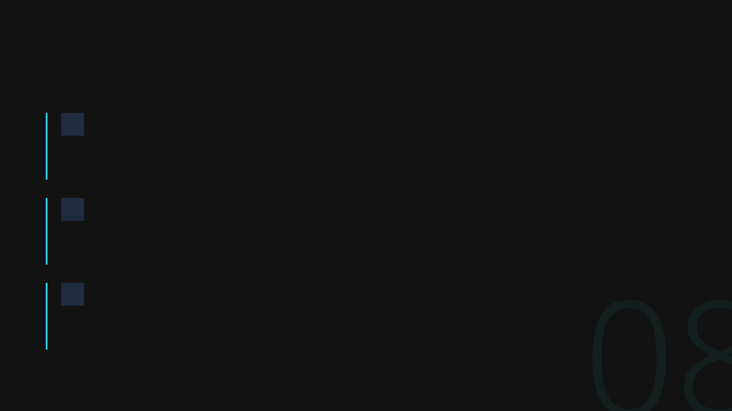
Assembly Line B
Refactor
Automated Code Translation
AI-powered tools convert legacy languages to modern equivalents whilst preserving business logic and behaviour.
Library Modernisation
Systematic replacement of deprecated dependencies with supported alternatives, including automated testing.
08
Strangler Fig Pattern
Incremental migration that ensures zero-downtime cutovers by gradually replacing functionality.
Notes:
Assembly Line B focuses on Refactoring, which is where we systematically improve the internal structure of an application without changing its external behaviour. We're leveraging automated tools here to drive speed and consistency, particularly with Automated Code Translation to move off unsupported languages and onto modern equivalents. This is not a manual effort; it's an industrial process. Library Modernisation is another critical component, ensuring we replace deprecated dependencies with supported, secure alternatives, which immediately addresses a huge chunk of our security exposure. The Strangler Fig Pattern is the methodology that governs this work, allowing us to incrementally replace functionality piece by piece. This guarantees zero-downtime cutovers and ensures we maintain business continuity throughout the entire process. This line is about surgical, automated improvement, but some assets require a more fundamental transformation.

Slide 9
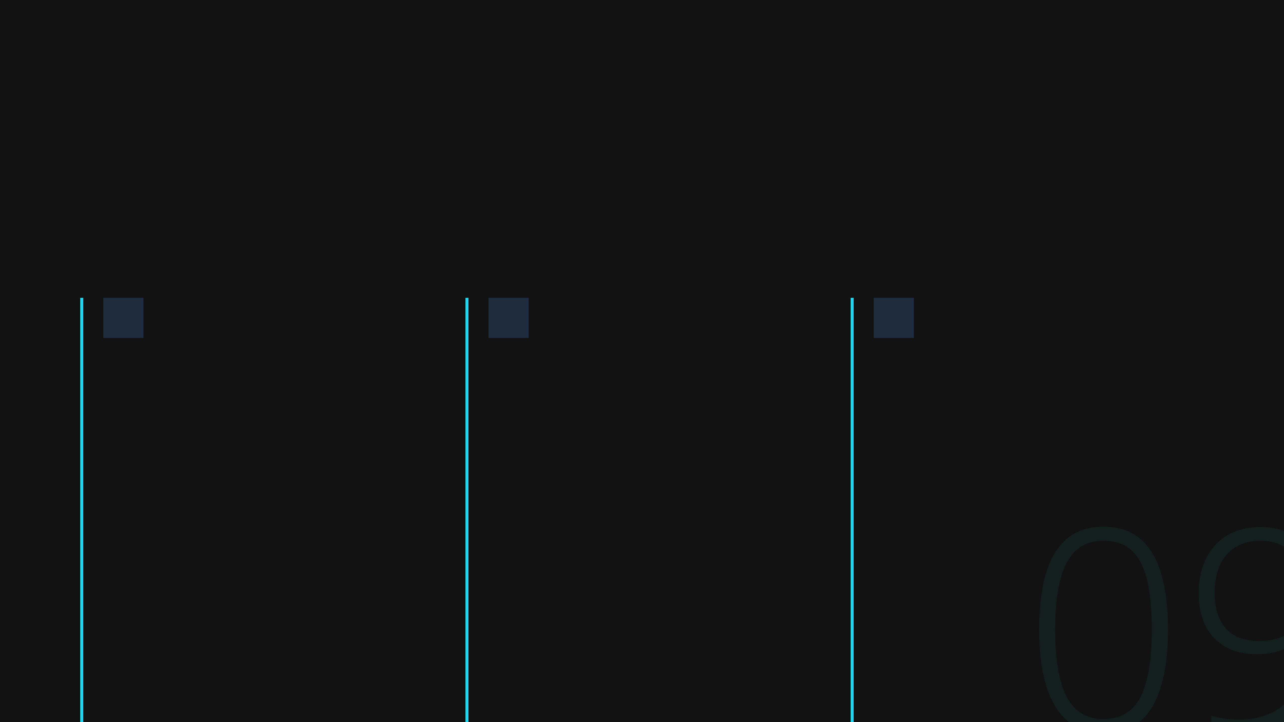
Assembly Line C
Rebuild
For high-value strategic assets, we employ Domain-Driven Design to completely rearchitect applications with modern patterns.
Domain-Driven Design
Event-Driven Architecture
Abstracting the Data Layer
Modelling business domains explicitly to create maintainable, evolvable architectures aligned with business needs.
Decoupled systems that communicate through events, enabling scalability and resilience.
Clean separation between business logic and data persistence, enabling technology flexibility.
09
Notes:
Assembly Line C, Rebuild, is reserved for our highest-value strategic assets—the systems that will define our future competitive advantage. This is a complete rearchitecture, moving away from the constraints of the past and building for the future. We employ Domain-Driven Design to ensure the new architecture perfectly models our core business domains, resulting in systems that are inherently more maintainable and evolvable. This is coupled with an Event-Driven Architecture, which creates highly decoupled, resilient, and scalable services that can react instantly to business events. Finally, we enforce a clean abstraction of the data layer, ensuring our business logic is entirely separate from the persistence technology. This gives us the flexibility to swap out databases or storage solutions without impacting the core application. Once an application has been through any of these three Assembly Lines, it must pass through our final gate: Quality Control.

Slide 10

The QA Gate
Quality Control
Every application passes through rigorous automated testing, security scanning, and compliance validation before deployment.
Automated Testing
Security Scanning
SRE Observability
Unit tests for all business logic
Static code analysis
Distributed tracing
Integration tests for APIs
Dependency vulnerability checks
Metrics and alerting
End-to-end user flows
Penetration testing
Log aggregation
10
Notes:
We've discussed the assembly lines, but none of that work matters if we don't have a rigorous quality gate. Quality Control isn't an afterthought here; it's the final, non-negotiable stage of industrialisation. We ensure functional parity and security by treating every application like a product leaving a factory floor. This means moving beyond manual checks and embedding automated testing into the very fabric of the process. We use comprehensive automated testing—unit, integration, and end-to-end—to guarantee that the modernised application behaves exactly as the legacy system did, but better. Furthermore, security is continuous, not a one-off audit. We run static code analysis and dependency checks throughout the pipeline, ensuring we aren't simply trading technical debt for security debt. Finally, we instrument everything for SRE observability before deployment. This means full distributed tracing and metrics, so we can monitor performance and quickly respond to incidents once the application is live. This rigorous approach is how we de-risk the entire modernisation effort. Now, let's look at why this industrialised approach is worth the investment.

Slide 11

Measurable Impact
The ROI of Industrialisation
The Modernisation Factory transforms technical debt from a growing liability into a managed, continuously improving asset.
Velocity
Cost Reduction
Talent Retention
Faster feature delivery through standardised, maintainable architectures that reduce complexity and accelerate development cycles.
Lower maintenance costs through automation and cloud-native infrastructure, freeing resources for strategic initiatives.
Engineers prefer working on modern tech stacks, reducing turnover and building organisational capability and expertise.
11
Notes:
This industrialised approach transforms technical debt from a growing liability into a managed, continuously improving asset. The return on investment here isn't just about saving money; it's about unlocking strategic value across the business. The most immediate impact is on velocity. By standardising our architectures and removing complexity, we dramatically accelerate our feature delivery cycles. Our teams can focus on innovation, not on navigating undocumented, brittle legacy code. Secondly, we achieve significant cost reduction. Automation and the move to cloud-native infrastructure slash our maintenance costs, freeing up capital that can be reinvested into strategic initiatives. Perhaps most critically, this improves talent retention. Our best engineers want to work on modern, well-architected systems, not wrestle with monolithic codebases. By giving them a modern tech stack and a clear framework, we reduce turnover and build a high-calibre internal capability. This shift from maintenance to innovation is the true ROI. So, how do we start capturing this value?

Slide 12

Call to Action
Phase 1: The Pilot
Begin with a 90-day pilot programme targeting three applications that represent different modernisation pathways. This proves the framework's effectiveness whilst building organisational capability.
Week 1–2
Application Selection
Identify three candidate applications representing different complexity levels and business criticality.
Week 3–4
Discovery & Triage
Run automated discovery tools, map dependencies, and assign modernisation pathways.
Week 5–10
Modernisation Execution
12
Execute the appropriate assembly line process for each application with continuous testing.
Week 11–12
Validation & Rollout
Final quality gates, production deployment, and measurement of success metrics.
Start the Pilot Programme
Transform your legacy estate into a strategic asset
Notes:
The best way to prove the framework's effectiveness and build internal capability is to start small and move quickly with a focused pilot programme. We aren't proposing a multi-year, big-bang transformation; we're suggesting a targeted, 90-day pilot. We begin by selecting three applications that represent different levels of complexity and business criticality. This ensures we test the full range of our assembly lines. Over the next two weeks, we run the automated discovery and triage, mapping dependencies and assigning the optimal modernisation pathway for each application. The core execution phase takes about six weeks, where we apply the appropriate assembly line—Encapsulation, Refactor, or Rebuild—with continuous quality checks. The final two weeks are dedicated to validation, production deployment, and measuring the success metrics we agreed upon upfront. This pilot gives us the data, the confidence, and the operational blueprint to scale the Modernisation Factory across the entire estate. The time to stop paying the legacy tax is now. Let's start the pilot programme and transform our legacy estate into a strategic asset.

